Slide 1

Conditionals and Loops

Slide 2
If Statement
Execute a certain block of code only if a certain condition is true.

Slide 3
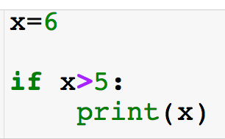
If Statement
Execute a certain block of code only if a certain condition is true
Conditional: must return boolean
If statements always begin with an “if”

Slide 4
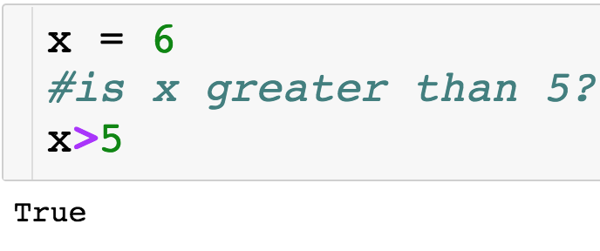
If Statement
Execute a certain block of code only if a certain condition is true
Conditional: must return boolean
If statements always begin with an “if”

Slide 5
If Statement
Execute a certain block of code only if a certain condition is true
Conditional: must return boolean
“:” ends statement
If statements always begin with an “if”

Slide 6
If Statement
Execute a certain block of code only if a certain condition is true
Conditional: must return boolean
“:” ends statement
If statements always begin with an “if”
If condition is true, then indented line of code will run

Slide 7
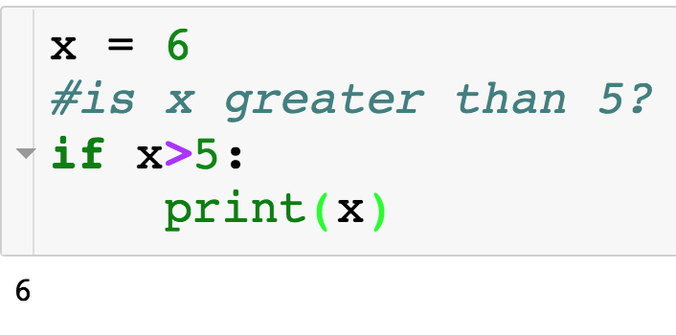
If Statement

Slide 8
If + Else Statement
Else statement allows us to specify separate directions if the condition with the if is False.

Slide 9
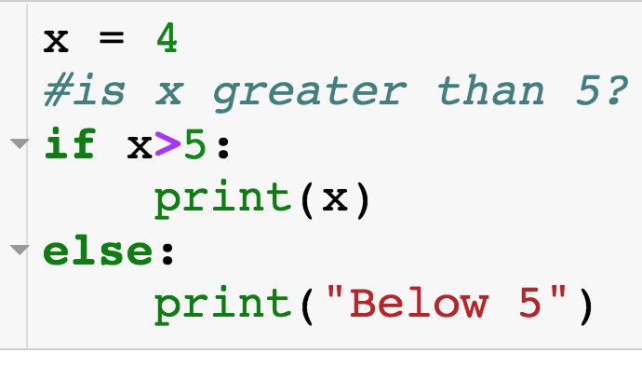
If + Else Statement
Else statement allows us to specify separate directions if the condition with the if is False.
Else always executes when the if condition is False.
Match if + else by indentation
Else is optional, meaning an if statement doesn’t have to have an accompanying else.

Slide 10
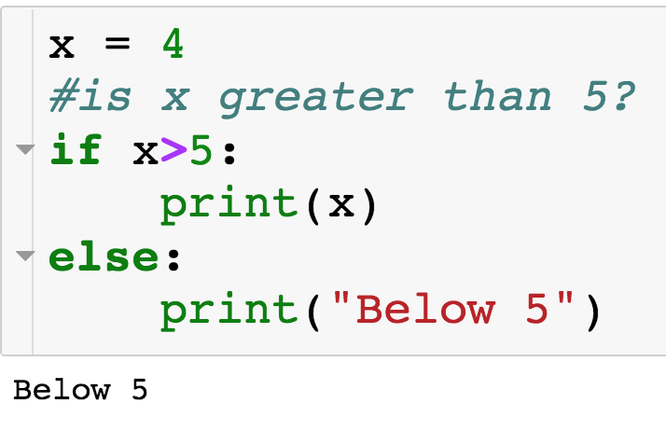
If + Else Statement
If condition is False, so code inside of else executes

Slide 11
If + Elif + Else Statement
How do I specify multiple conditions?...

Slide 12
If + Elif + Else Statement
How do I specify multiple conditions?...elif

Slide 13
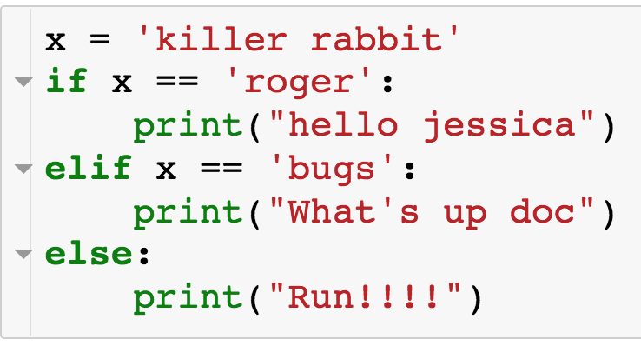
If + Elif + Else Statement
How do I specify multiple conditions?...elif
Comes between if and else
Can have arbitrary number of elifs
First if/elif condition that is true is executed and only this block is executed
If no if/elif condition is true then else is executed
Indentation matches up if/elif/else statements

Slide 14
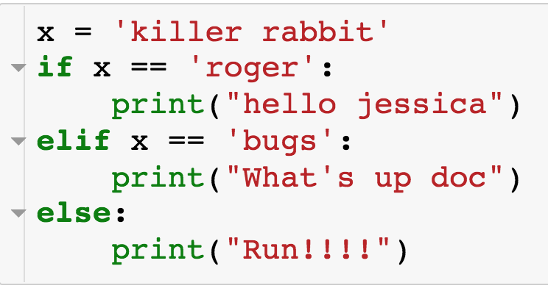
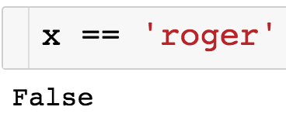
If + Elif + Else Statement

Slide 15
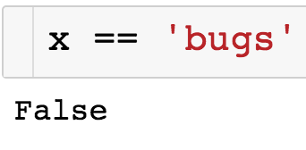
If + Elif + Else Statement

Slide 16
If + Elif + Else Statement
Since all if/elif conditions were False, else statement executes

Slide 17
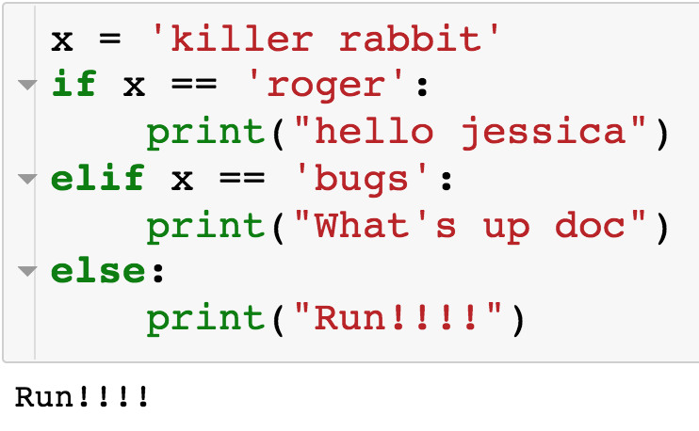
If + Elif + Else Statement

Slide 18
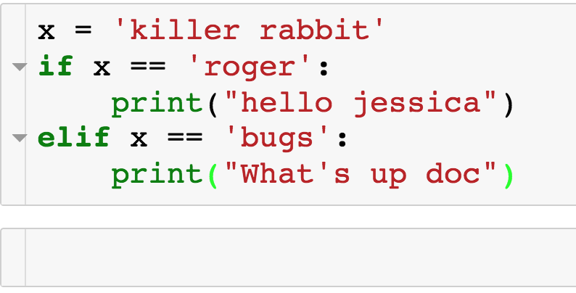
If + Elif + Else Statement
We can just have an if + elif, with no else:

Slide 19
If + Elif + Else Statement
We can just have an if + elif, with no else:
Nothing is printed since neither if not elif condition is true

Slide 20
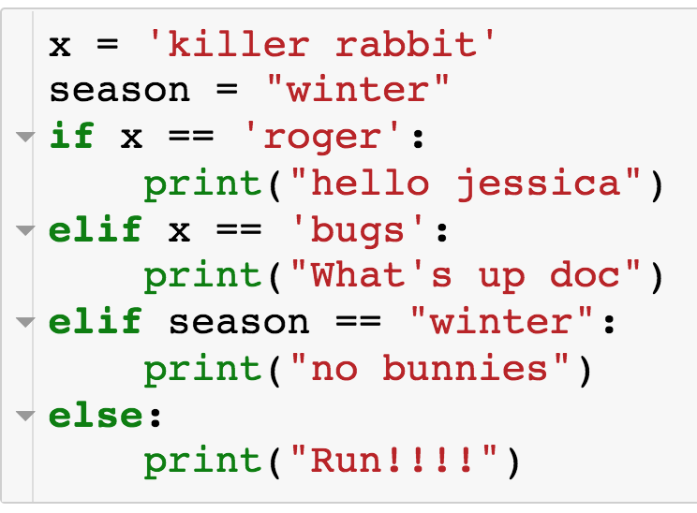
If + Elif + Else Statement
Example with multiple elif conditions:

Slide 21
If + Elif + Else Statement
Example with multiple elif conditions:

Slide 22
If + Elif + Else Statement
Example with multiple elif conditions:

Slide 23
If + Elif + Else Statement
Example with multiple elif conditions:

Slide 24
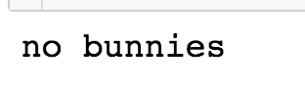
If + Elif + Else Statement
Example with multiple elif conditions:

Slide 25
If + Elif + Else Statement
Example with multiple elif conditions:

Slide 26
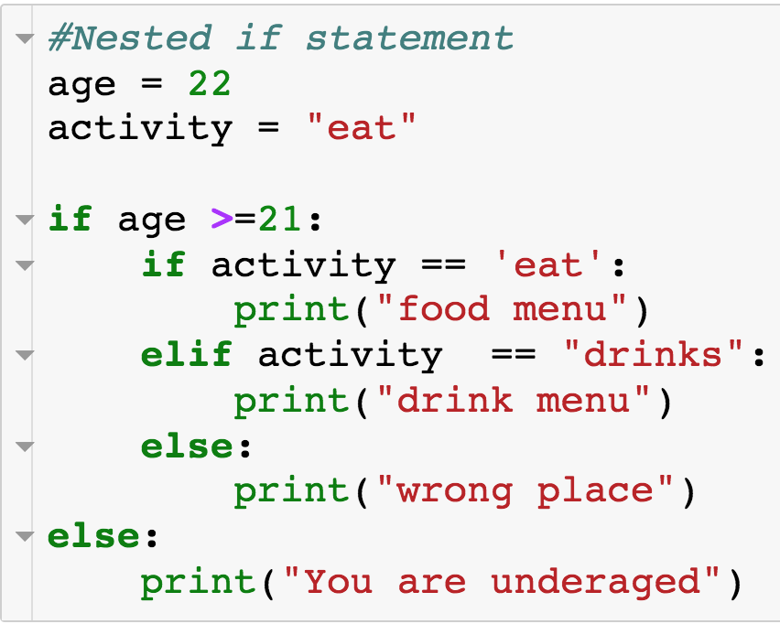
Nested Conditionals
We can have if statements nested within if statements:

Slide 27
Nested Conditionals
We can have if statements nested within if statements:

Slide 28
Nested Conditionals
We can have if statements nested within if statements:

Slide 29
Nested Conditionals
We can have if statements nested within if statements:

Slide 30
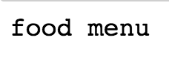
Nested Conditionals
We can have if statements nested within if statements:

Slide 31
Specifying Multiple Conditions
How do you specify multiple conditions in a conditional statements?

Slide 32
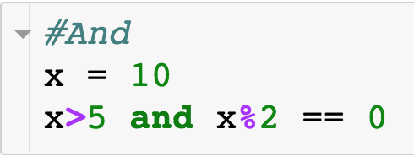
Specifying Multiple Conditions - and
How do you specify multiple conditions in a conditional statements?
Condition 1
Condition 2
Conditional statements w/ “and”

Slide 33
Specifying Multiple Conditions - and
How do you specify multiple conditions in a conditional statements?
Condition 1
Condition 2
AND
All conditions must evaluate to True
Can have arbitrary number of conditions

Slide 34
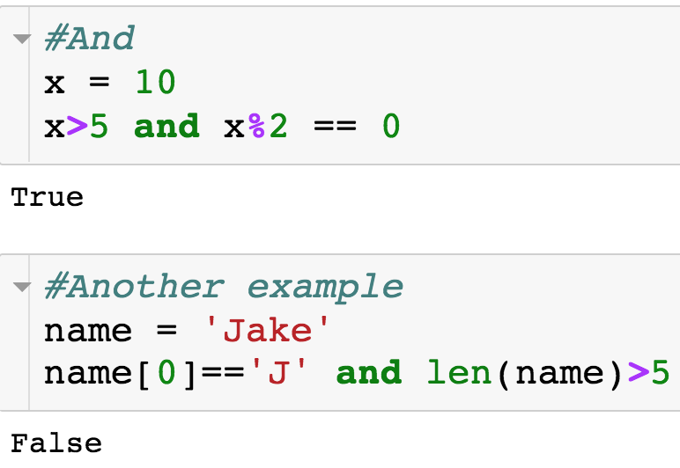
Specifying Multiple Conditions - and
How do you specify multiple conditions in a conditional statements?

Slide 35
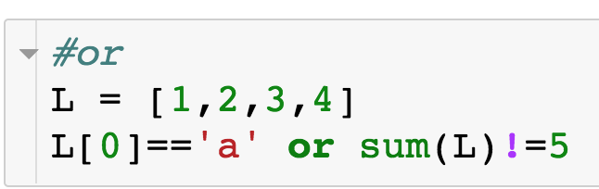
Specifying Multiple Conditions - or
How do you specify multiple conditions in a conditional statements?
Condition 1
Condition 2
Conditional statements w/ “or”

Slide 36
Specifying Multiple Conditions - or
How do you specify multiple conditions in a conditional statements?
Condition 1
Condition 2
OR
At least one condition must evaluate to True
Can have arbitrary number of conditions

Slide 37
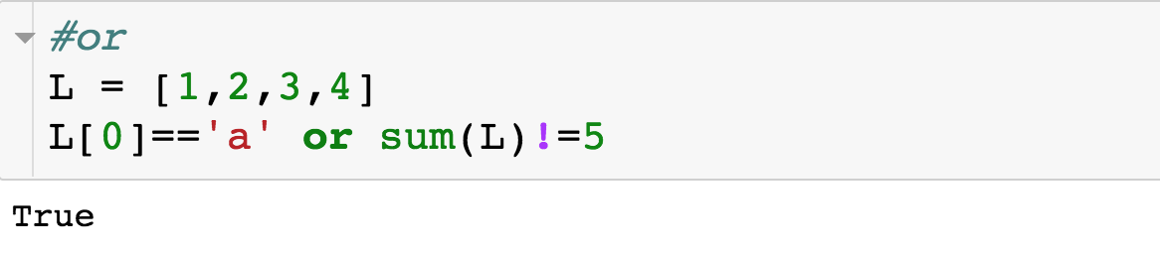
Specifying Multiple Conditions
How do you specify multiple conditions in a conditional statements?

Slide 38
Specifying Multiple Conditions
How do you specify multiple conditions in a conditional statements?

Slide 39
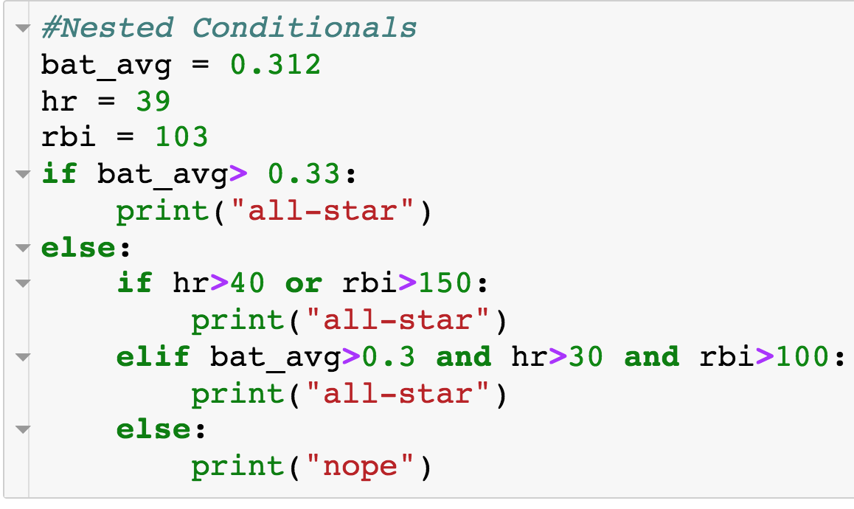
Nested Conditionals + and/or

Slide 40
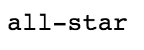
Nested Conditionals

Slide 41
For Loops
Use cases of for loops:
Iterate over the elements of a list or string
For each element, perform some sort of operation - count or sum
Perform some action a specified number of times
Deal out 5 cards
Have a student go through all 100 lockers

Slide 42
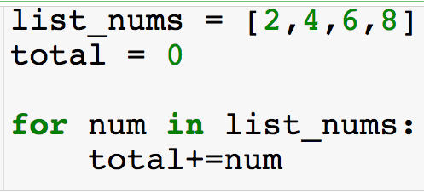
For Loops w/ List
Compute sum of elements of a list
Use for loop to iterate over the elements of the list

Slide 43
For Loops w/ List
Compute sum of elements of a list
Use for loop to iterate over the elements of the list
Keyword “for”
Loop variable – takes on each value of loop target
Loop target – object to be iterated over

Slide 44
For Loops w/ List
Can call loop variable whatever you want
Block of code to run each iteration of for loop

Slide 45
For Loops w/ List

Slide 46
For Loops w/ List

Slide 47
For Loops w/ List

Slide 48
For Loops w/ List

Slide 49
For Loops w/ List

Slide 50
For Loops w/ List

Slide 51
For Loops w/ List

Slide 52
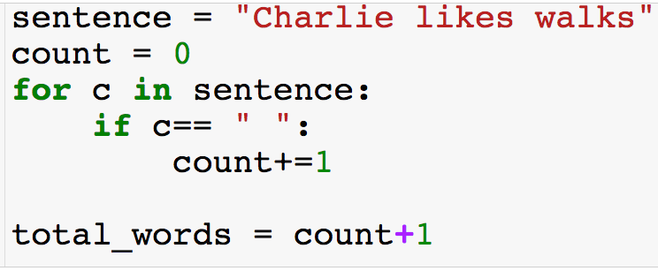
For Loops w/ Strings
Now the loop target is a string
Compute the number of words in sentence

Slide 53
For Loops w/ Strings

Slide 54
For Loops w/ Strings

Slide 55
For Loops w/ Strings

Slide 56
For Loops w/ Strings

Slide 57
For Loops w/ Strings
…

Slide 58
For Loops w/ Strings

Slide 59
For Loops w/ Strings

Slide 60
For Loops w/ Strings

Slide 61
For Loops w/ Strings

Slide 62
For Loops w/ Strings

Slide 63
Summary: For Loops w/ Strings or Lists
The loop target can be a string or a list
If the loop target is a list – iterate over the elements of the list by increasing index
If the loop target is a string – iterate over the characters of the string by increasing index
We will see other python objects that can be loop for targets

Slide 64
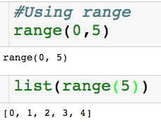
Range
start (defaults to 0 if left off)
end (non-inclusive)
Built-in range function

Slide 65
Range
start (defaults to 0 if left off)
end (non-inclusive)
Built-in range function
Can use range(0,n) as loop target
Need consecutive integers
Need to repeat something n times

Slide 66
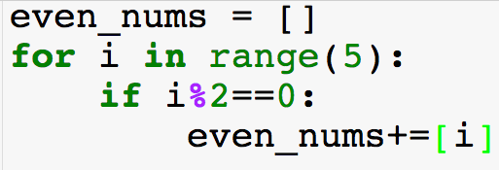
For Loops w/ Range
Using range() as loop target to get consecutive integers
Compute even numbers >=0

Slide 67
For Loops w/ Range

Slide 68
For Loops w/ Range

Slide 69
For Loops w/ Range

Slide 70
For Loops w/ Range

Slide 71
For Loops w/ Range

Slide 72
For Loops w/ Range

Slide 73
For Loops w/ Range

Slide 74
For Loops w/ Range

Slide 75
For Loops w/ Range

Slide 76
For Loops w/ Range
Using range() as loop target to do something n times.
Loop variables will not be used
Get n random samples of U[0,1]

Slide 77
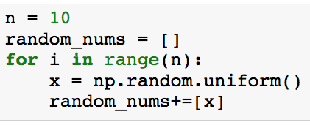
For Loops w/ Range
Using range() as loop target to do something n times.
Loop variables will not be used
Get n random samples of U[0,1]
Loop will run n times

Slide 78
For Loops w/ Range
Using range() as loop target to do something n times.
Loop variables will not be used
Get n random samples of U[0,1]
Loop will run n times
Generates U[0,1]

Slide 79
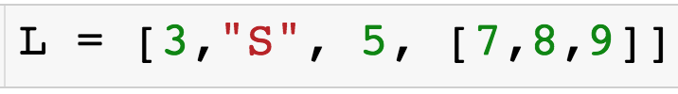
For Loops w/ Range
How do I iterate over the indices of a list using a for loop?

Slide 80
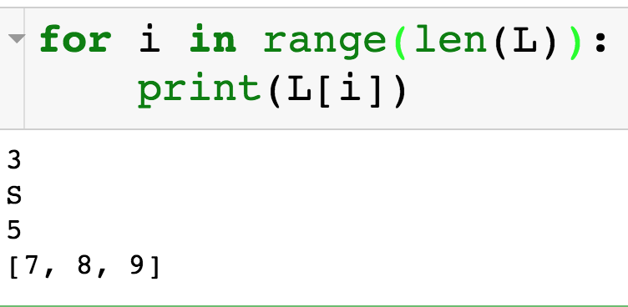
For Loops w/ Range
How do I iterate over the indices of a list using a for loop?

Slide 81
For Loops w/ Range
How do I iterate over the indices of a list using a for loop?
Why would I ever need to do this?

